Slide 1

REQUIREMENT ANALYSIS & DESIGN (RAD)
GENERAL CONFEDERATION OF LABOR OF VIETNAM
TON DUC THANG UNIVERSITY
FACULTY OF INFORMATION TECHNOLOGY
JEWELRY ONLINE SALES SYSTEM

Slide 2
Introduction
Shopping has long been considered a recreational activity by many. Shopping online is no exception. The goal of this application is to develop a web based on interface for online retailers. The system would be easy to use and hence make the shopping experience pleasant for the users.

Slide 3
Actor
Web Customer:
New Customer: will be an official customer and can order after successful registration.
Register Customer: customers registered as official members and are allowed to place orders
Shop Owner: perform product management and have the right to add, delete, edit that related to the staffs as well as he can register account and review report of clerk

Slide 4
Actor
Clerk: has function as sales, payment and product management after measuring the report every day to the shop owner.
Credit Payment Service: provide payment services to the store by credit card
PayPal: provide payment services to the store by Paypal.
<<Service>>Authentication: this is a service use to authenticate the credentials, usually account names and passwords of customer.

Slide 5
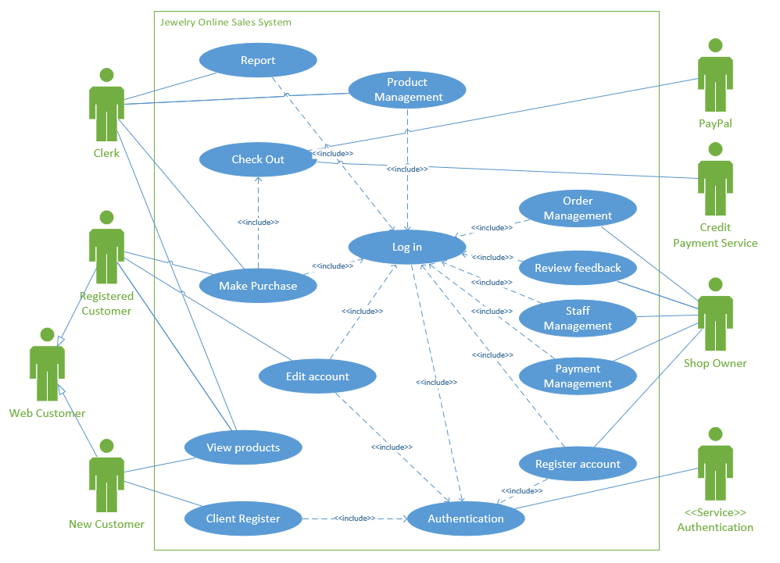
Use case Diagram
This is the use case diagram for Jewelry online sales system.

Slide 6
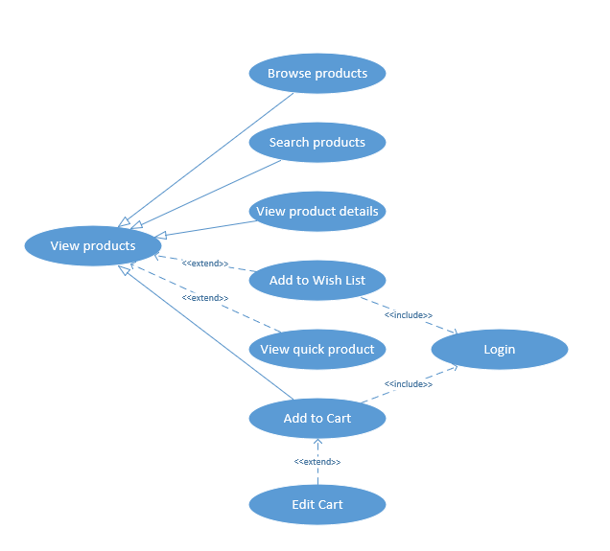
Use case Diagram
This is sub use case diagram for View products.

Slide 7
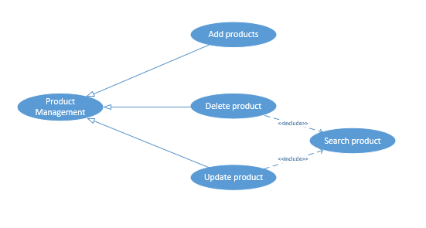
Use case Diagram
This is sub use case diagram for Product Management

Slide 8
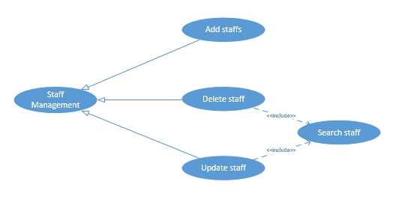
Use case Diagram
This is sub use case diagram for Staff Management

Slide 9
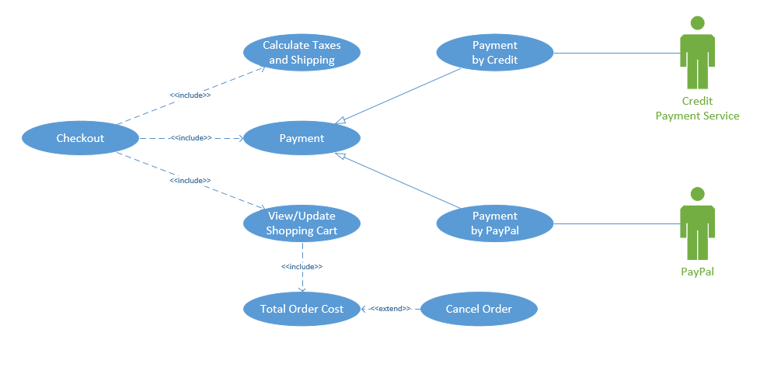
Use case Diagram
This is sub use case diagram for Checkout

Slide 10
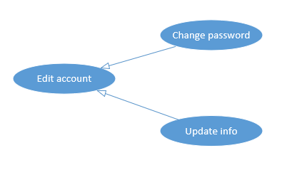
Use case Diagram
This is sub use case diagram for Edit account

Slide 11
List of Use case
There are 14 top level use cases: View products, Client Register, Edit account, Make Purchase, Checkout, Report, Product Management, Login, Authentication, Register account, Payment Management, Staff Management, Review feedback, Order Management.

Slide 12
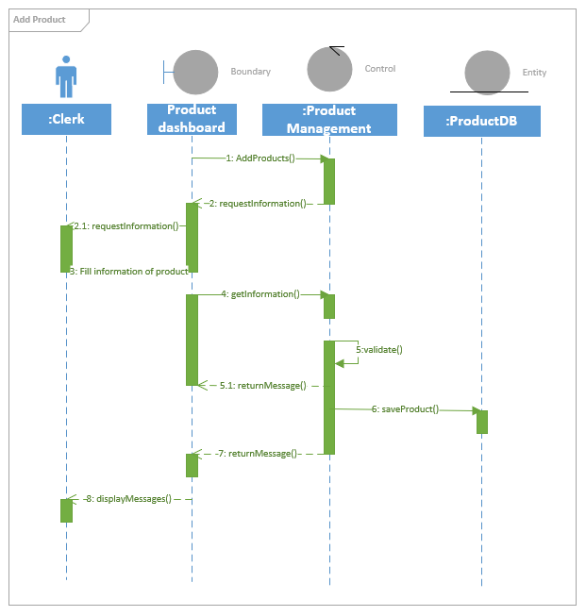
Sequence Diagram
Sequence diagram
for add product

Slide 13
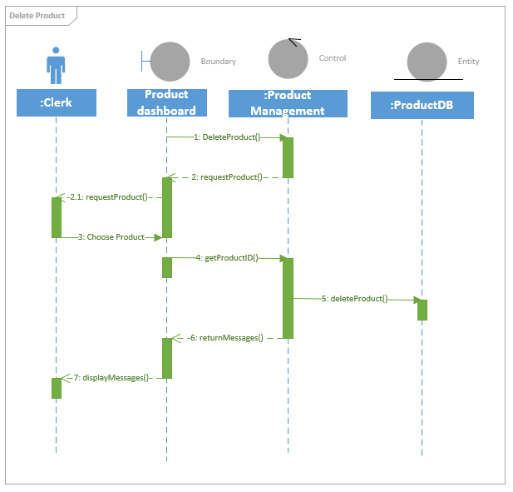
Sequence Diagram
Sequence diagram
for delete product

Slide 14
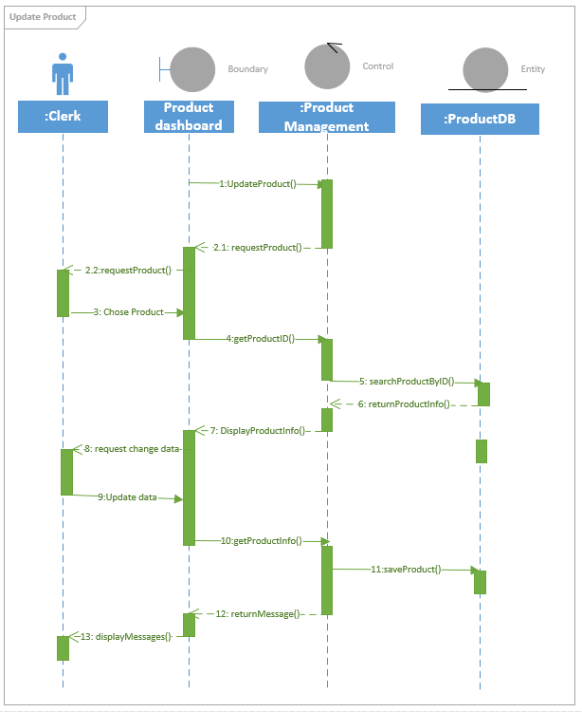
Sequence Diagram
Sequence diagram
for update product

Slide 15
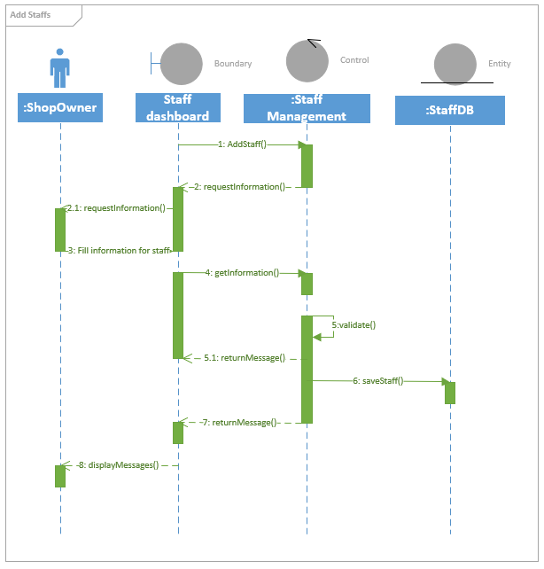
Sequence Diagram
Sequence diagram
for add staff

Slide 16
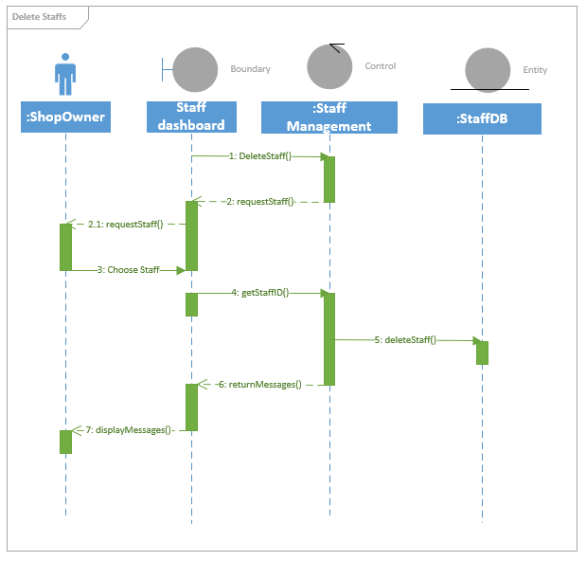
Sequence Diagram
Sequence diagram
for delete staff

Slide 17
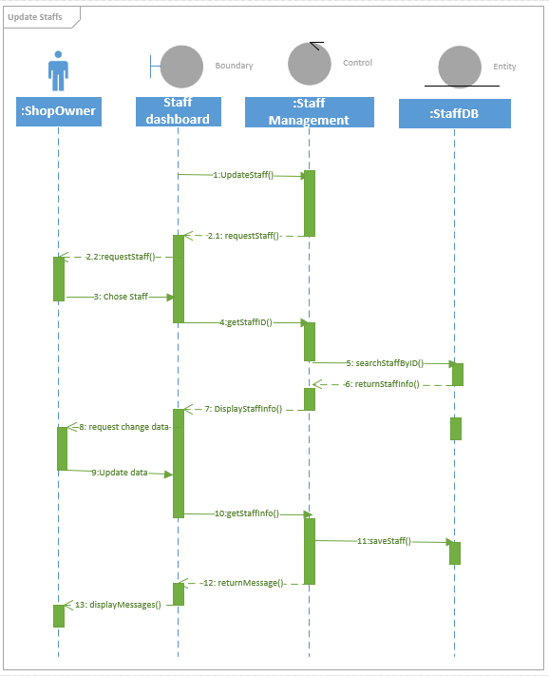
Sequence Diagram
Sequence diagram for
update staff

Slide 18
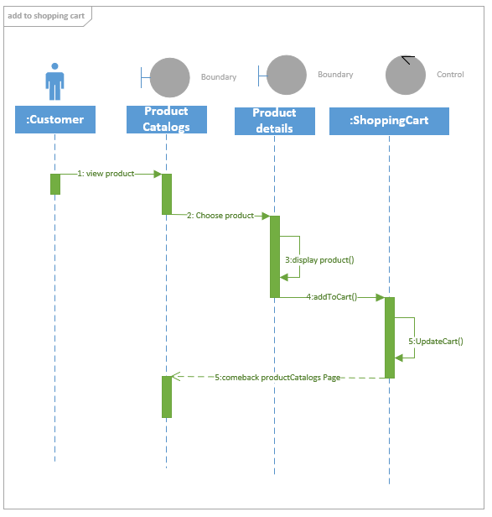
Sequence Diagram
Sequence diagram for
add to shopping cart

Slide 19
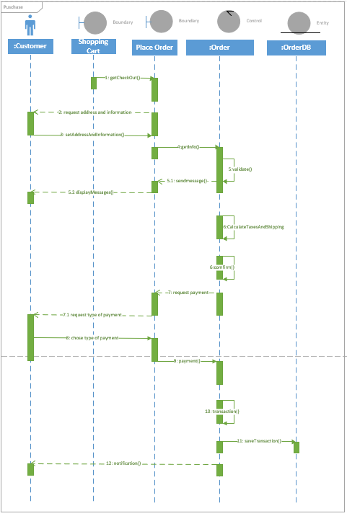
Sequence Diagram
Sequence diagram for purchase

Slide 20
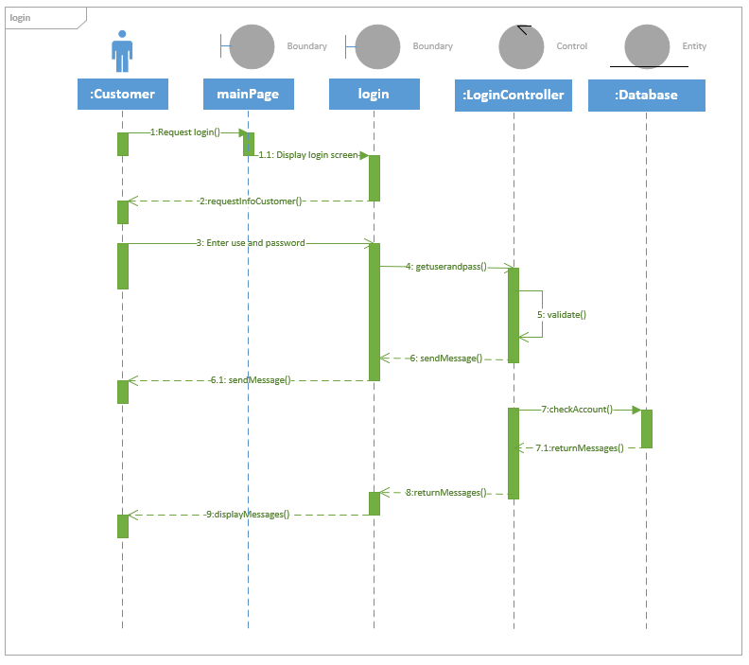
Sequence Diagram
Sequence diagram
for login

Slide 21
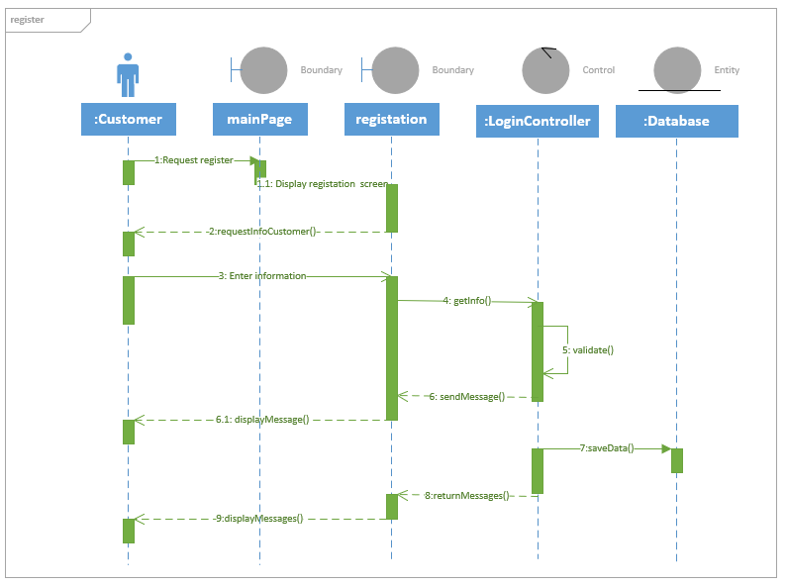
Sequence Diagram
Sequence diagram
for register

Slide 22
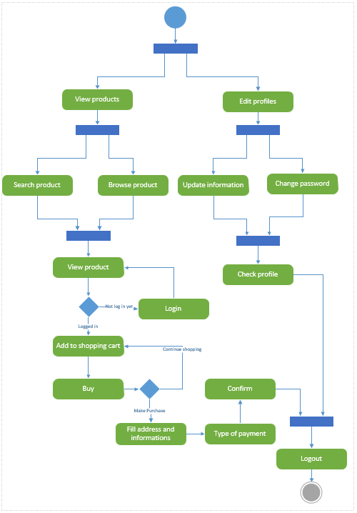
Activity Diagram
Activity diagram for customer

Slide 23
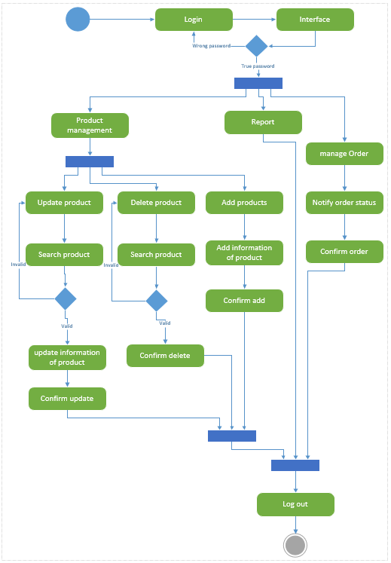
Activity Diagram
Activity diagram for clerk

Slide 24
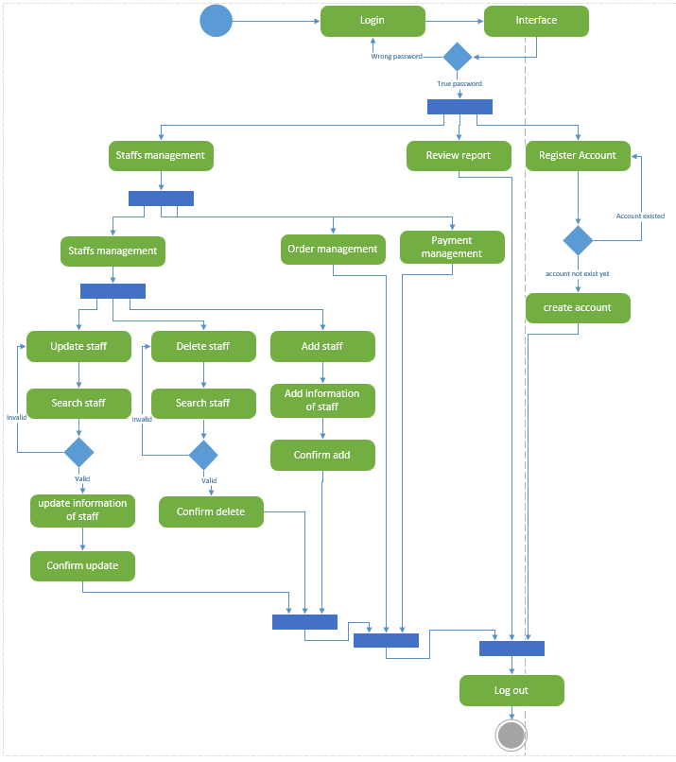
Activity Diagram
Activity diagram for
Shop Owner

Slide 25
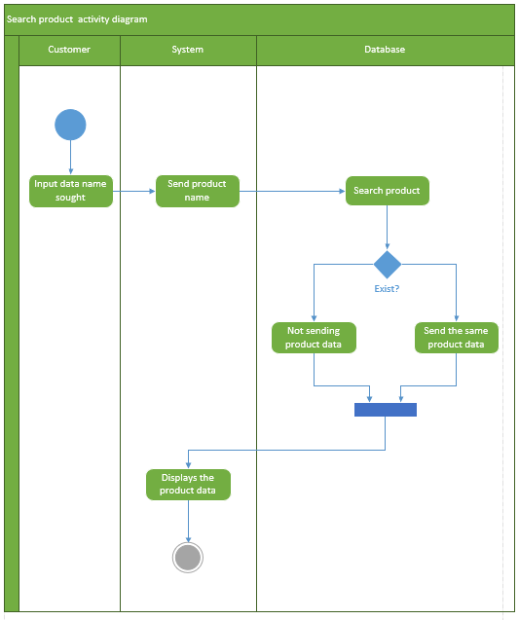
Activity Diagram
Activity diagram for
Search product

Slide 26
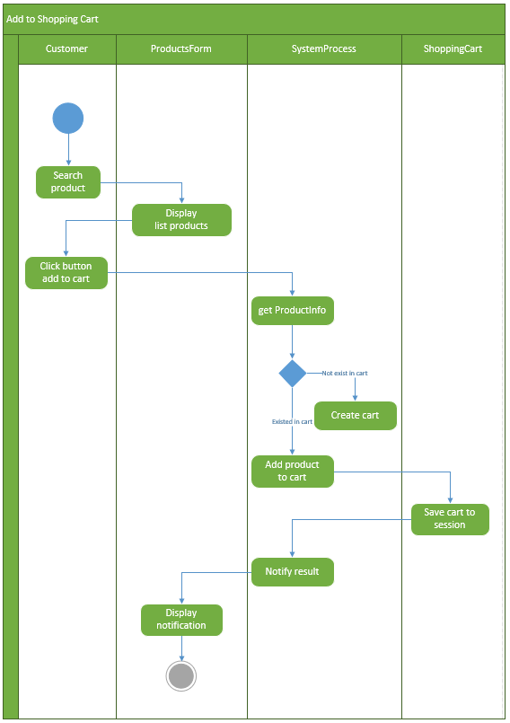
Activity Diagram
Activity diagram for
Add to shopping cart

Slide 27
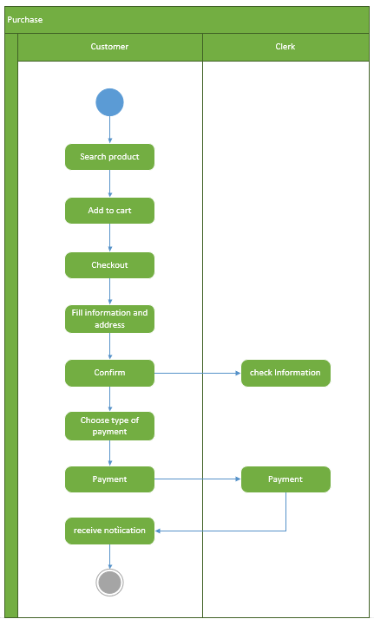
Activity Diagram
Activity diagram for purchase

Slide 28
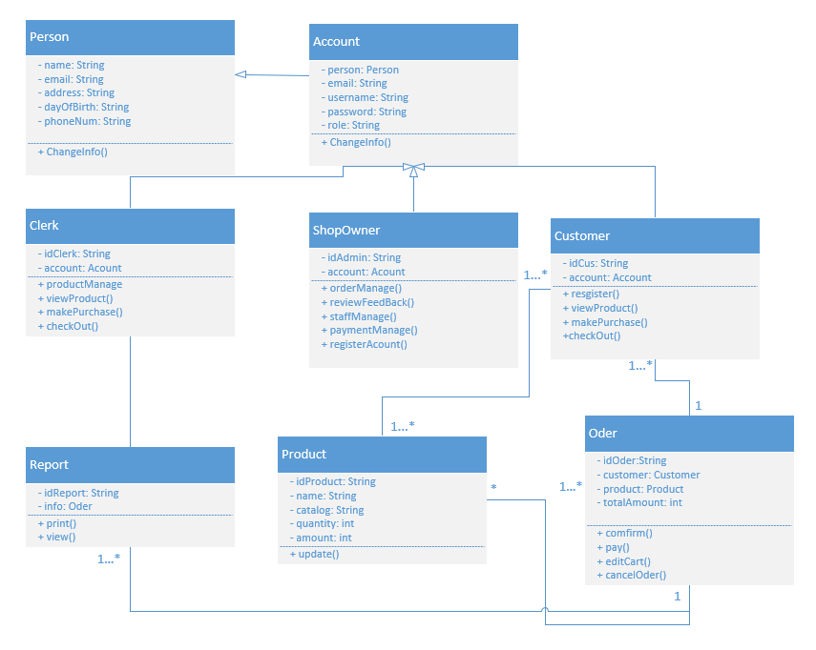
Class Diagram
Class diagram for
Jewelry online
shopping

Slide 29
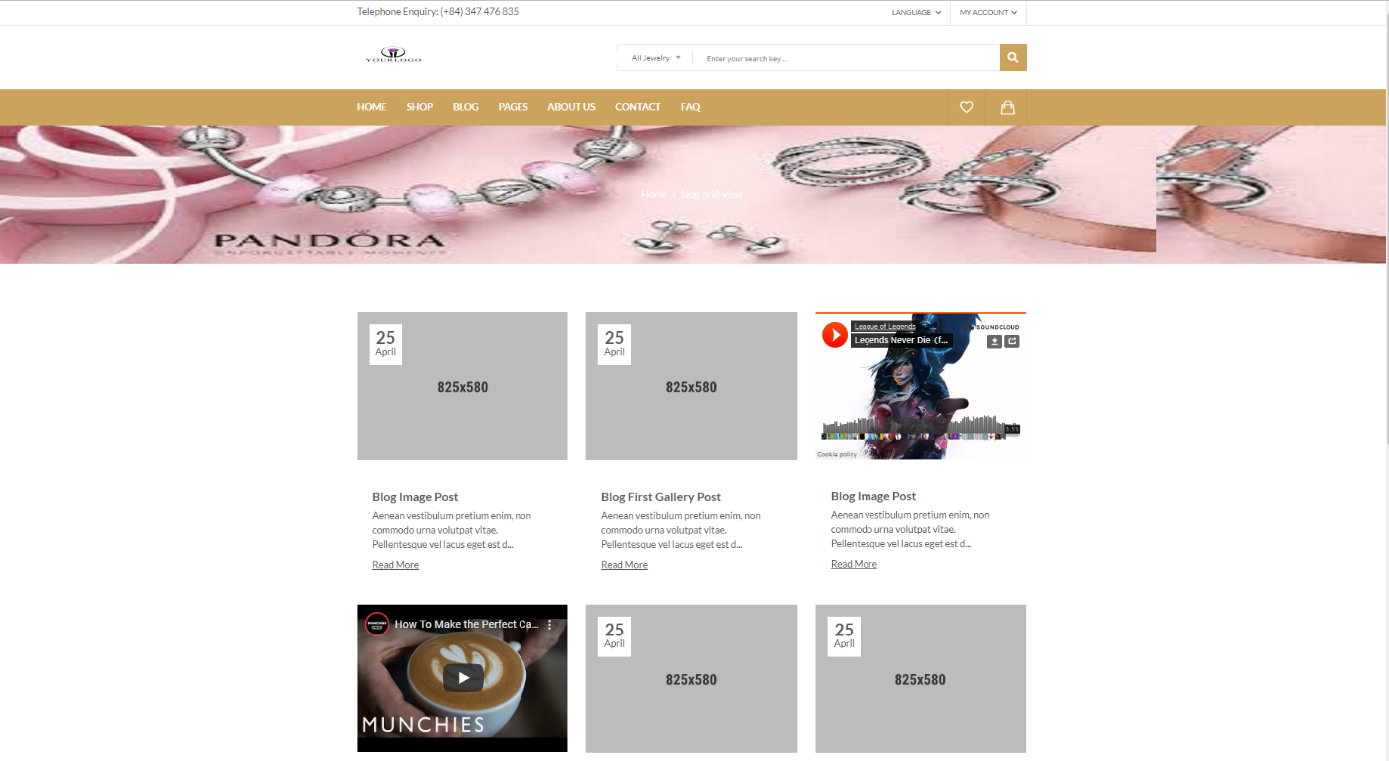
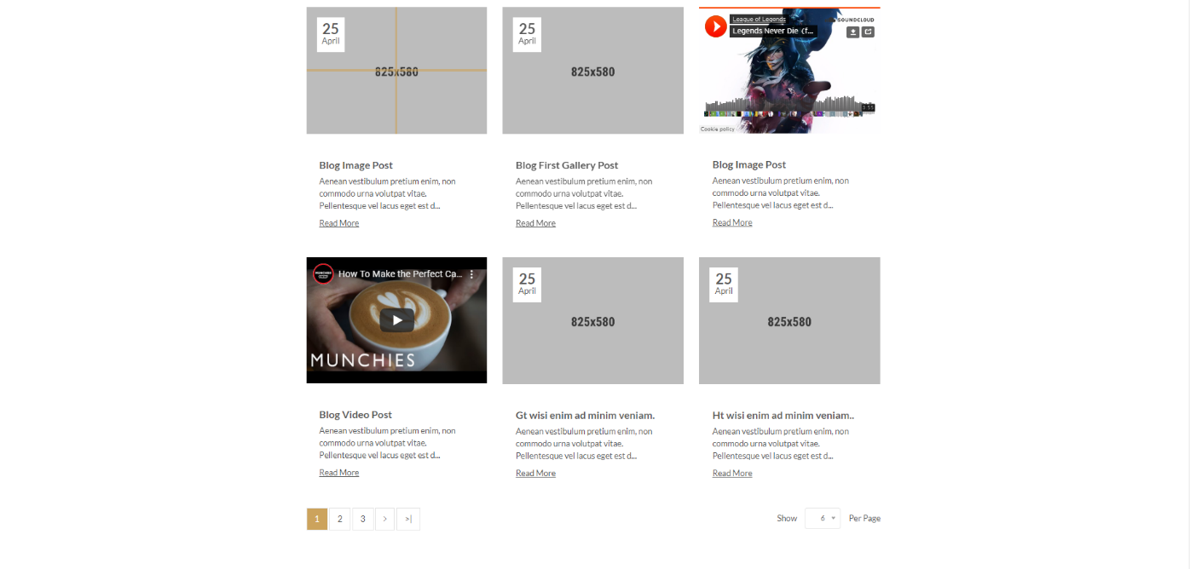
UI Design
UI of Blog Grid View page

Slide 30
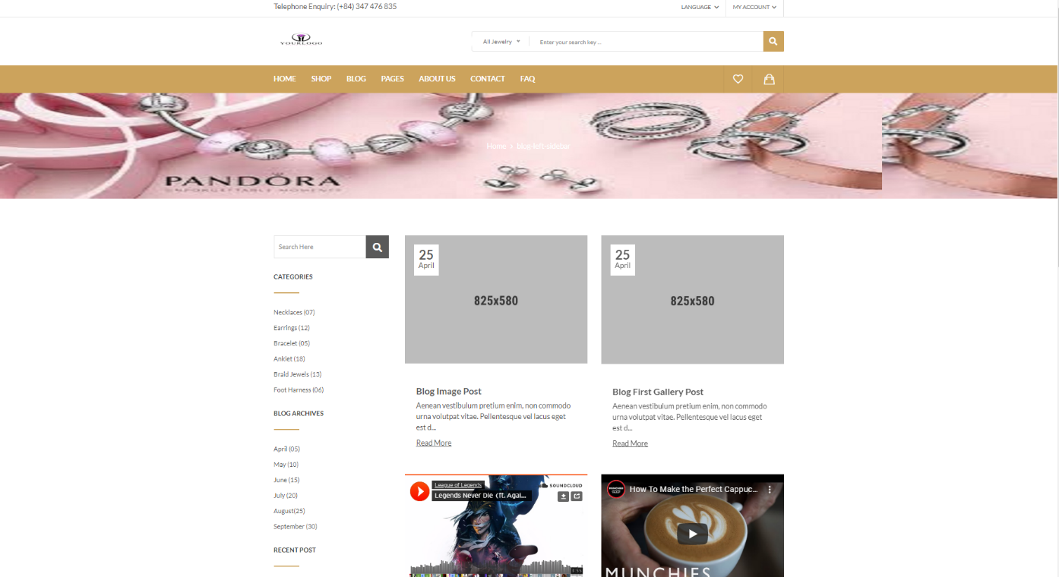
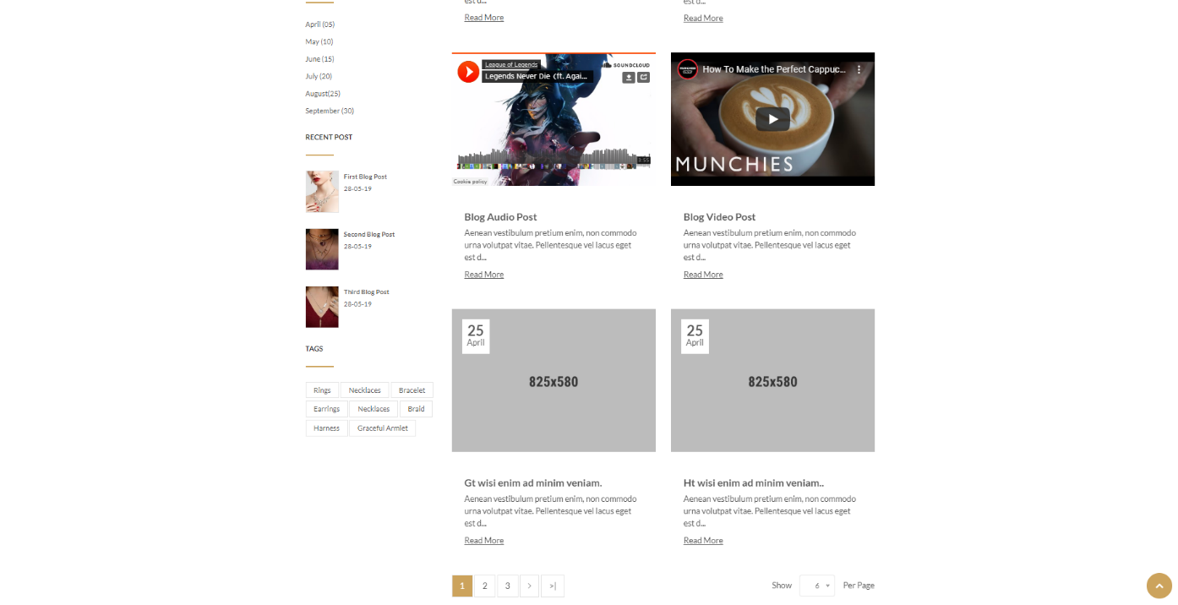
UI Design
UI of Blog Left Sidebar page

Slide 31
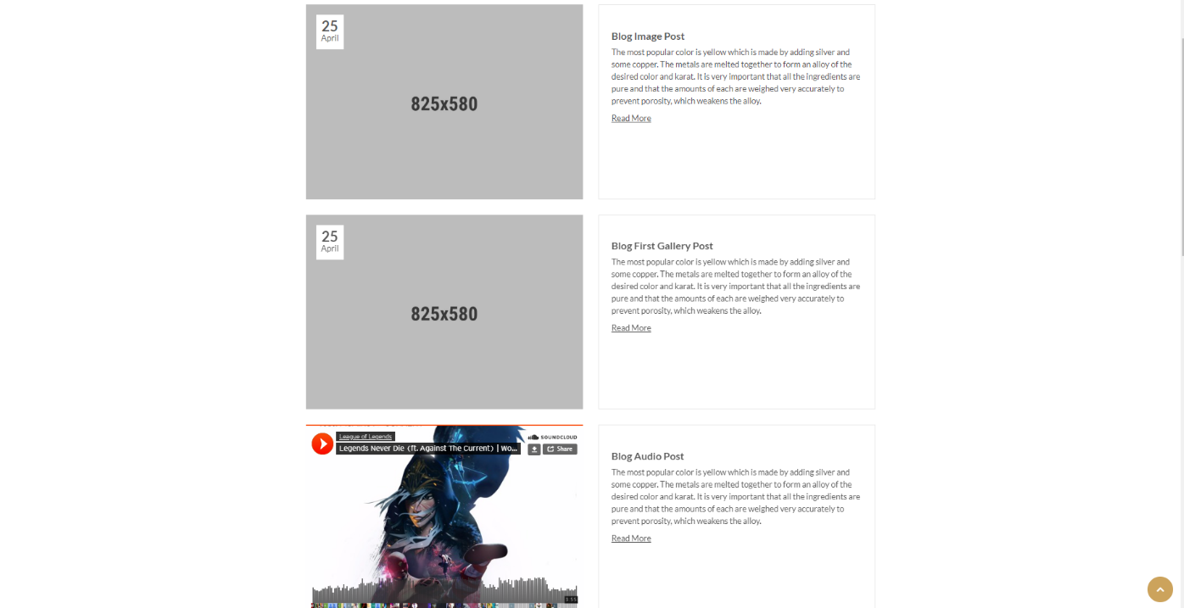
UI Design
UI of Blog List View page

Slide 32
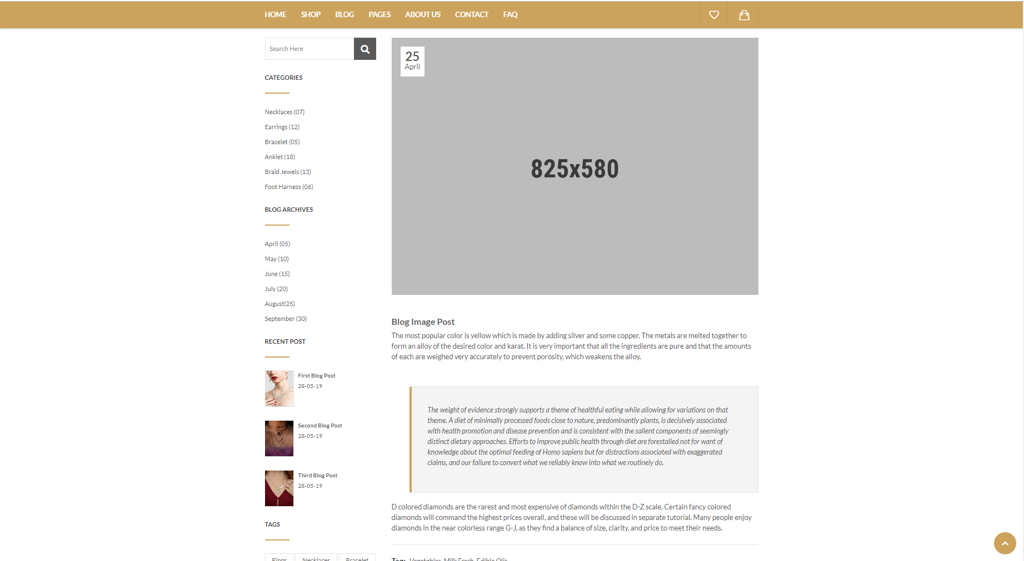
UI Design
UI of Detail’s Blog page

Slide 33
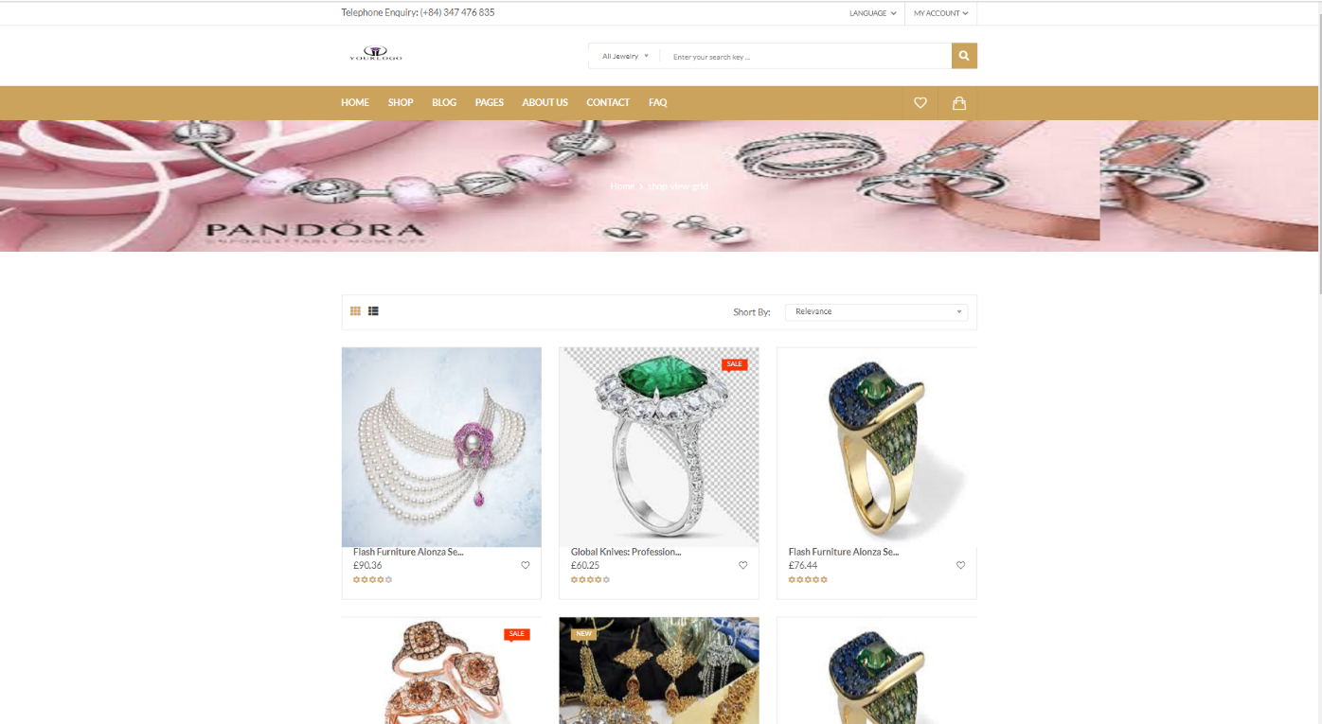
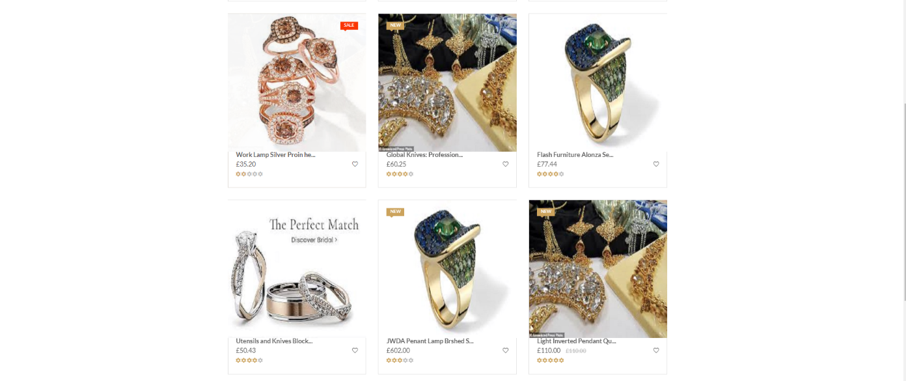
UI Design
UI of Shop Grid View page

Slide 34
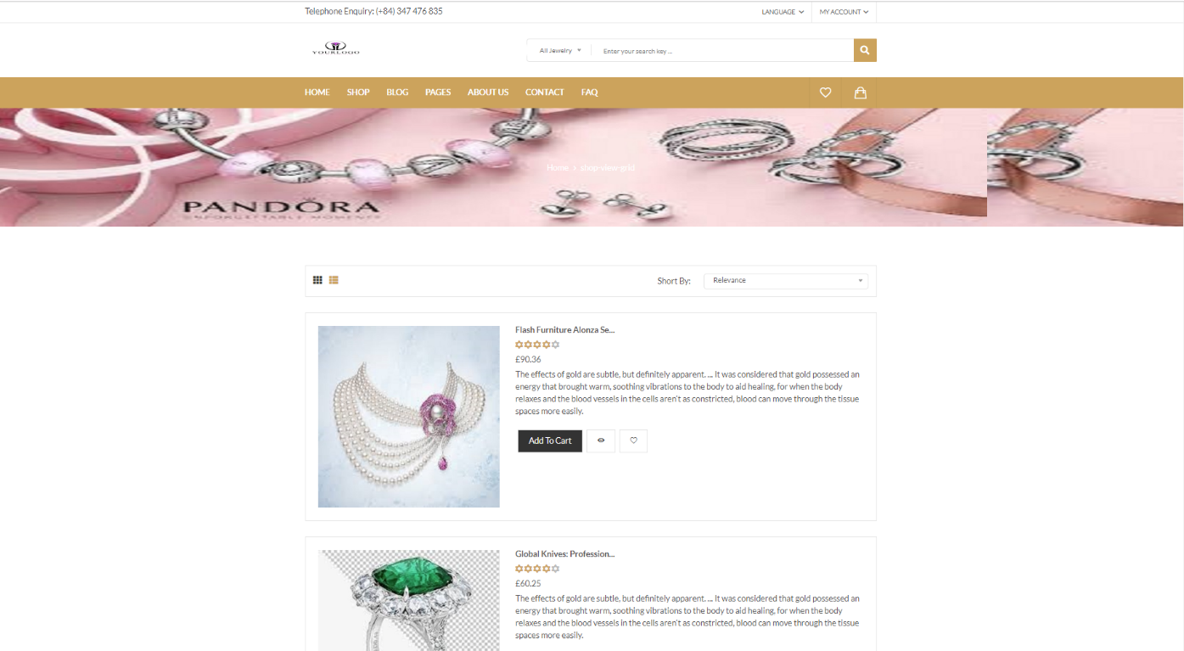
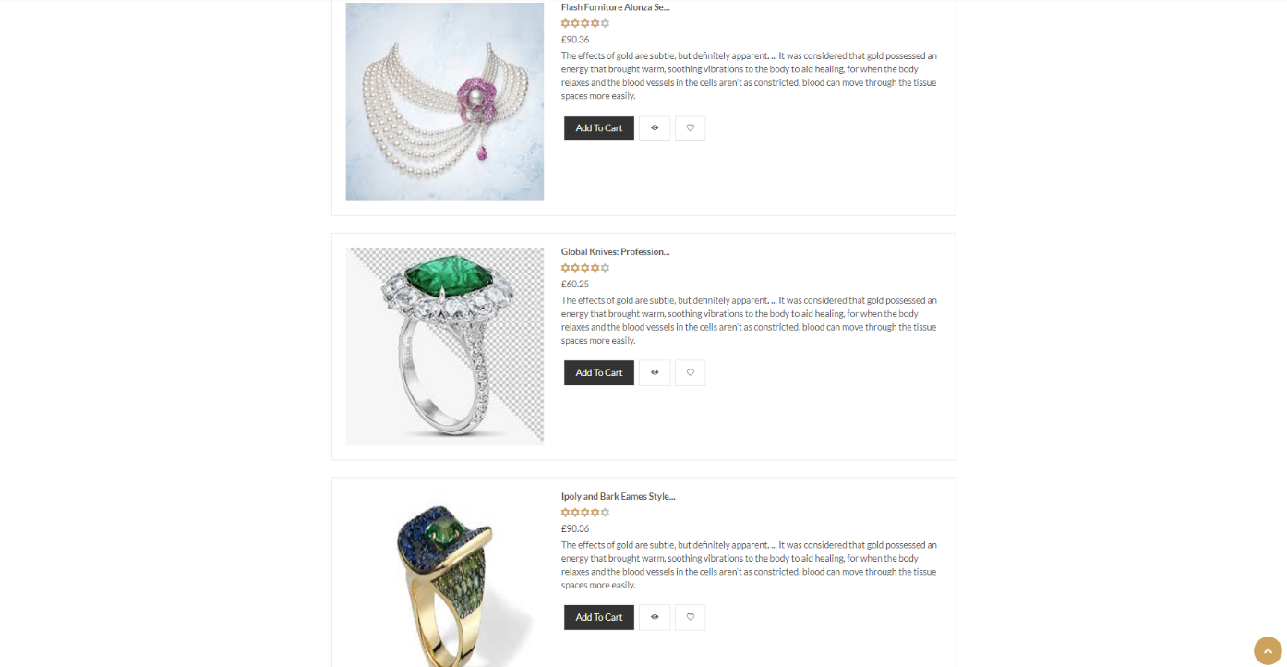
UI Design
UI of Shop List View page

Slide 35
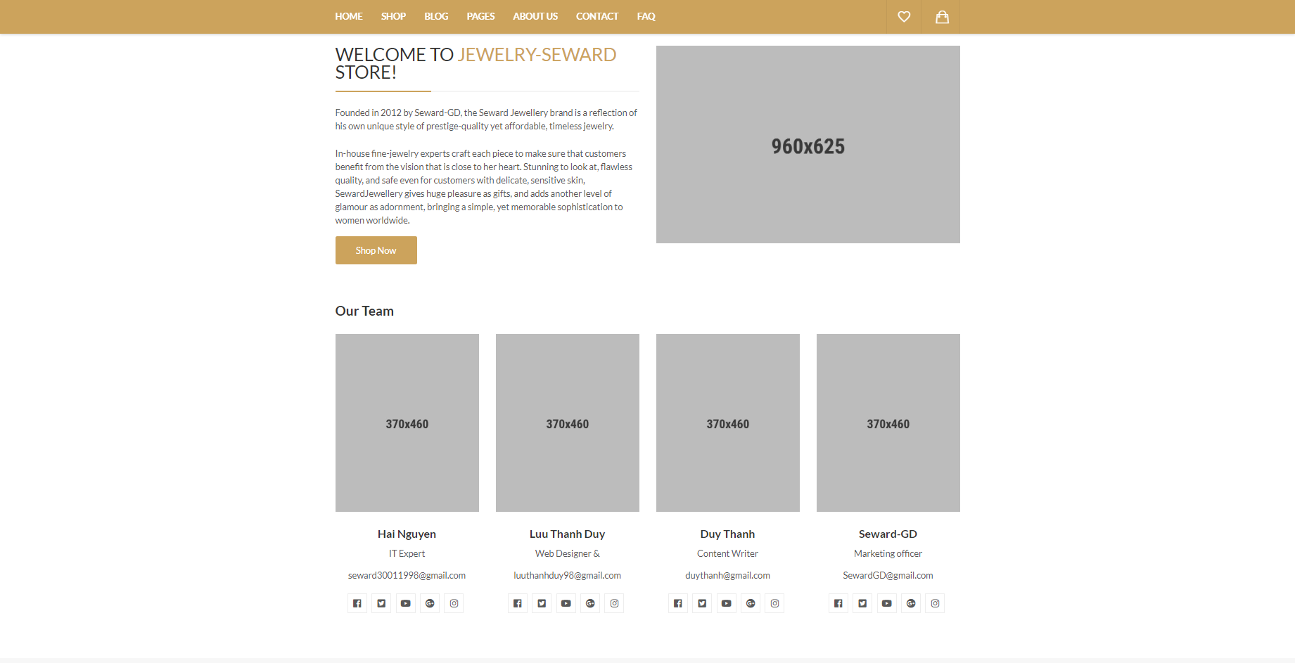
UI Design
UI of About Us page

Slide 36
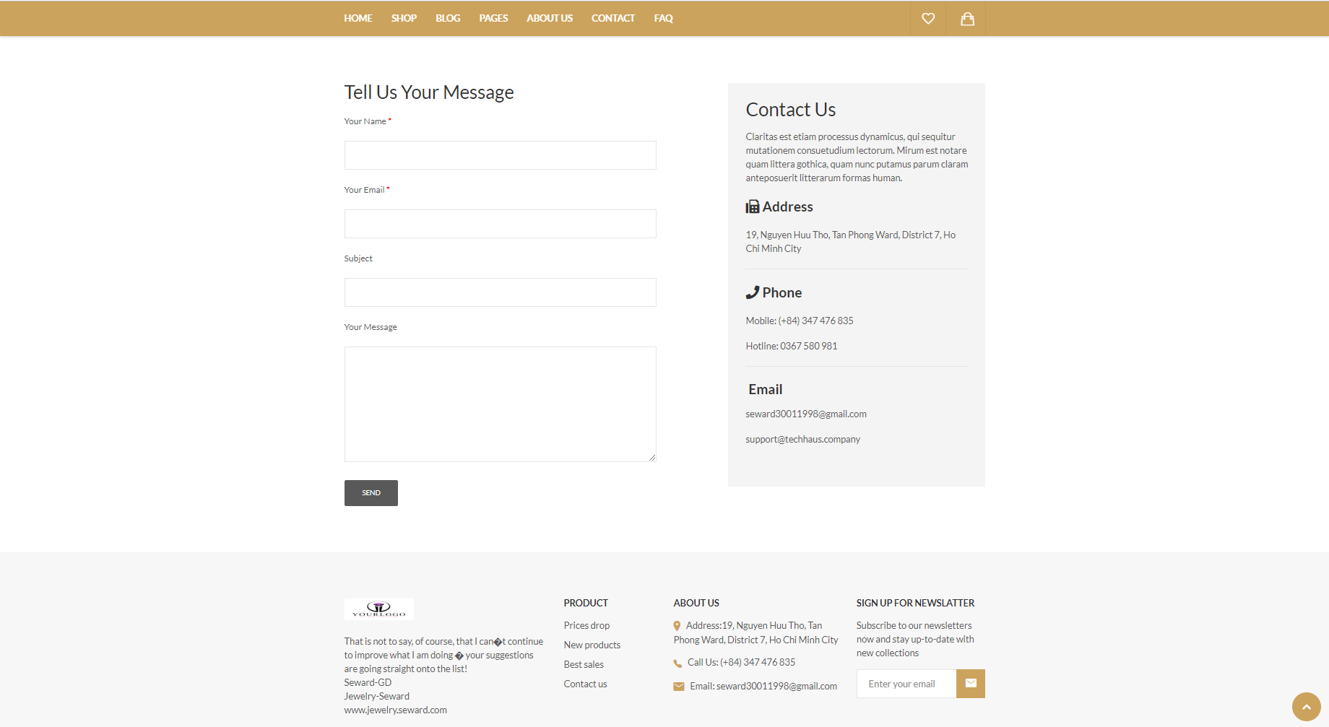
UI Design
UI of Contact page

Slide 37
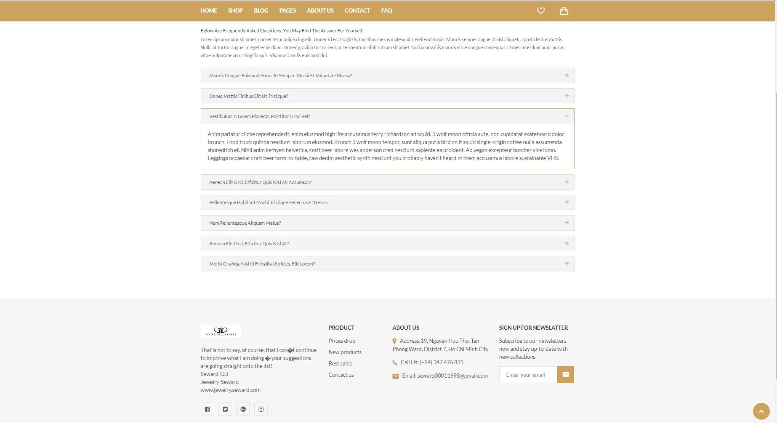
UI Design
UI of FAQ page

Slide 38
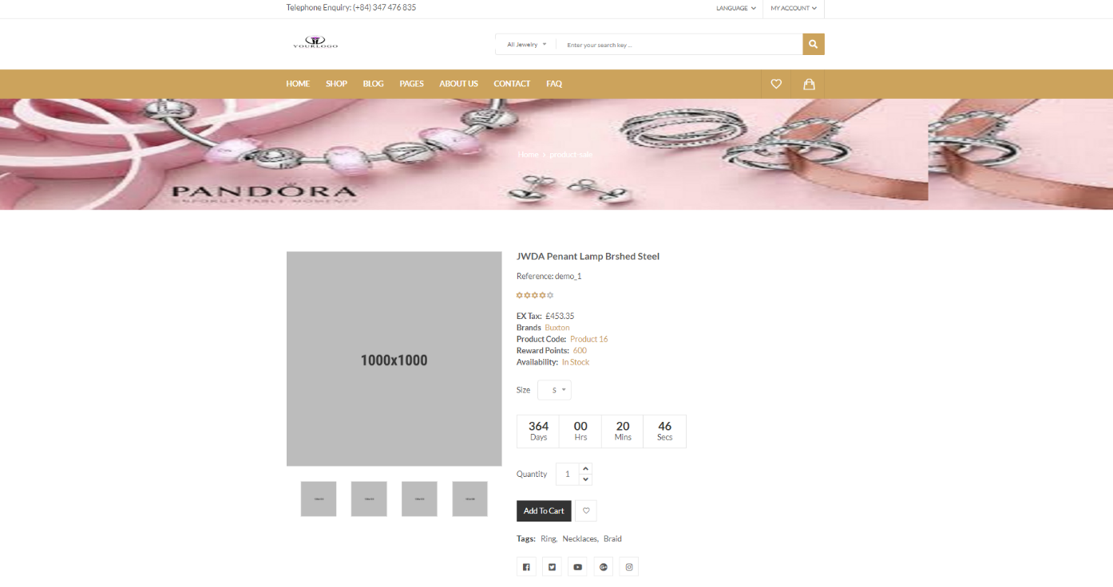
UI Design
UI of Sale Product Details page

Slide 39
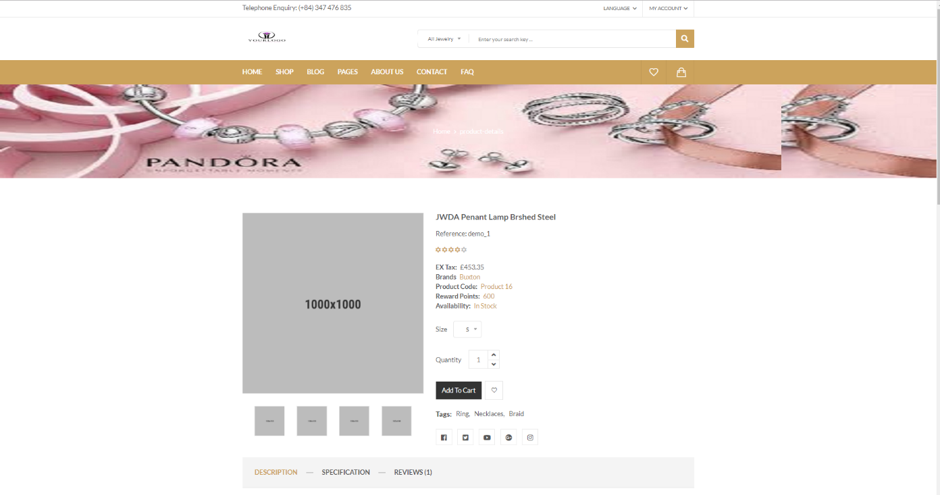
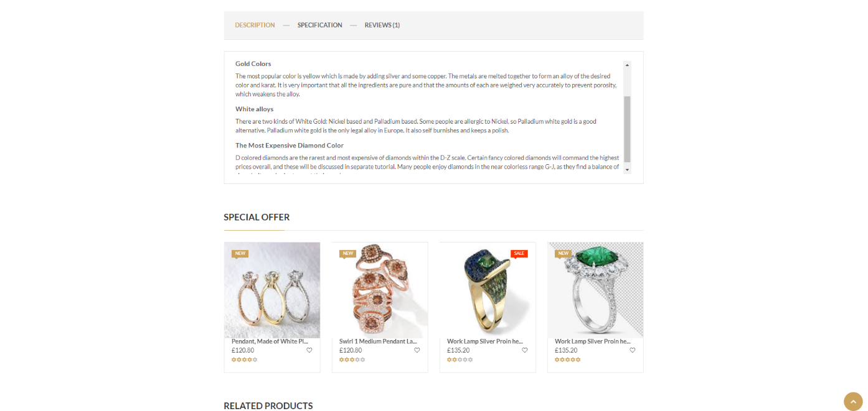
UI Design
UI of Detail Product page

Slide 40
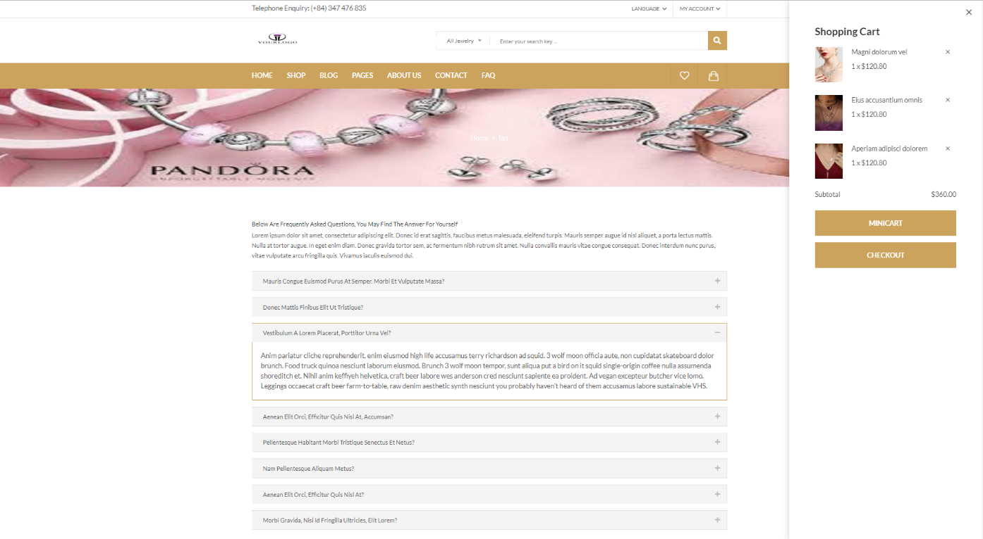
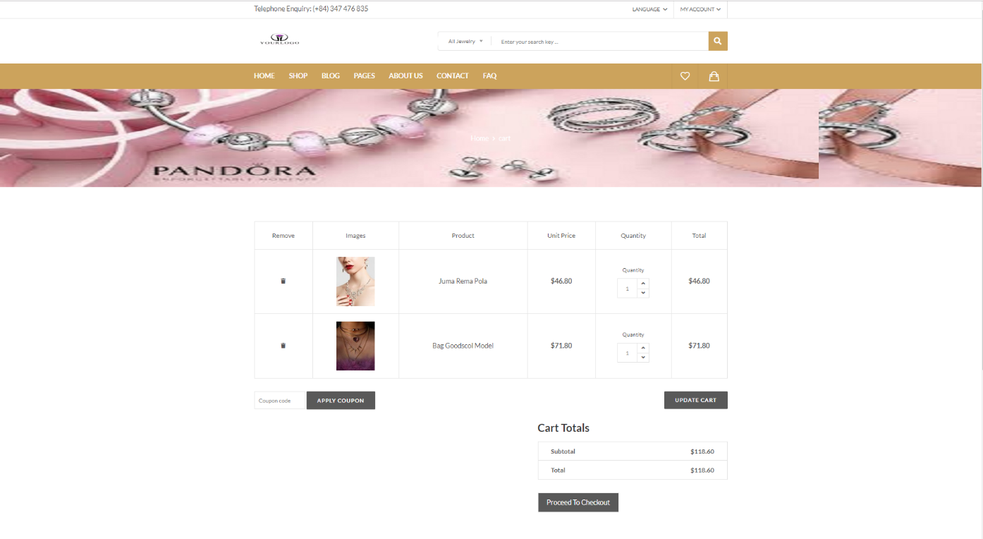
UI Design
UI of Shopping Cart page

Slide 41
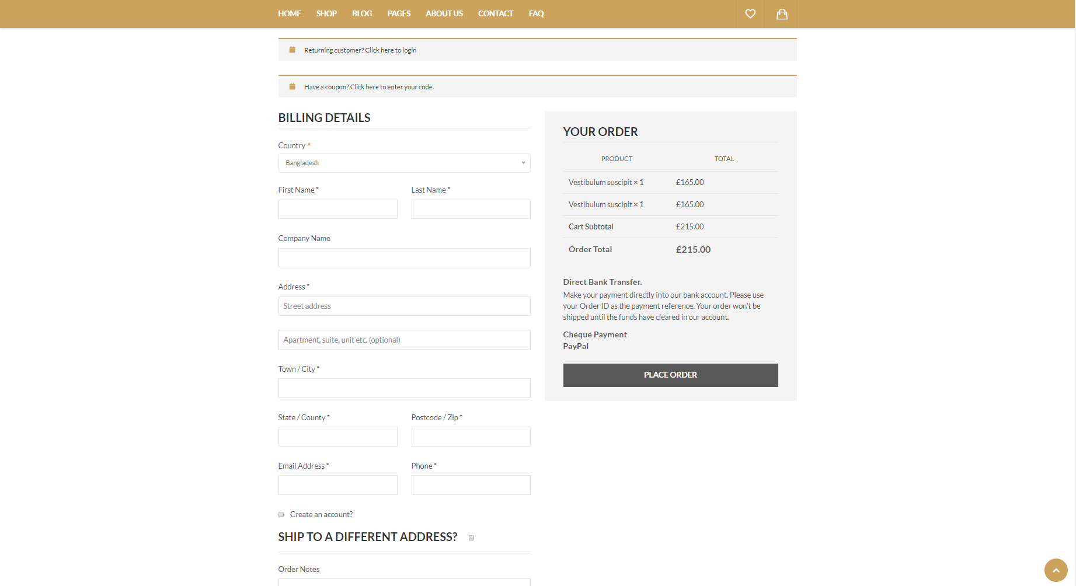
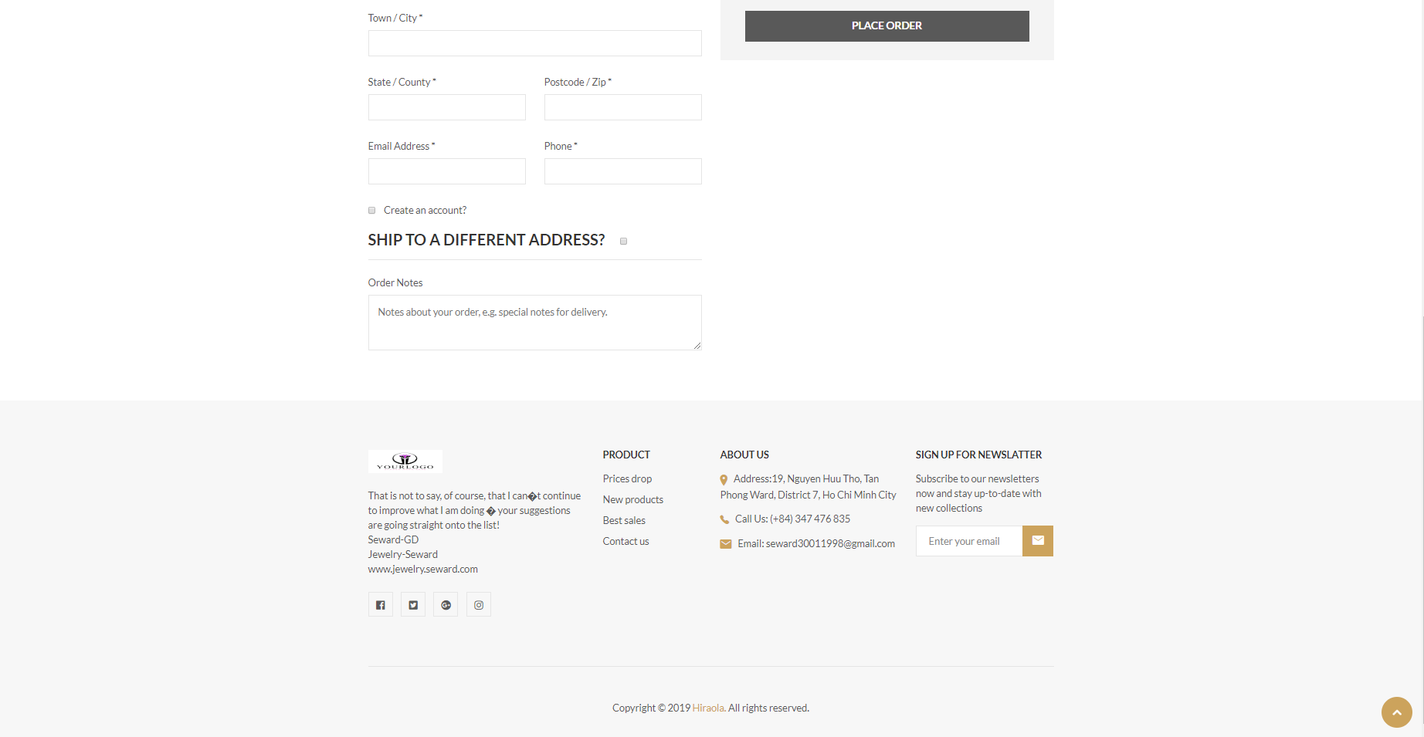
UI Design
UI of Checkout page

Slide 42
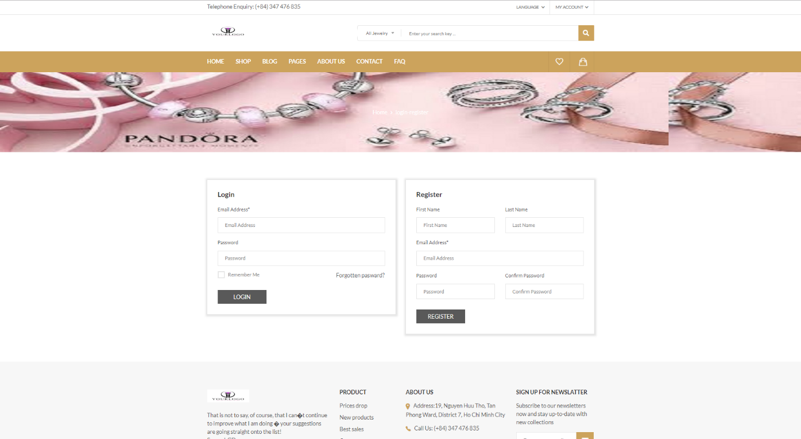
UI Design
UI of Login and Register page

Slide 43
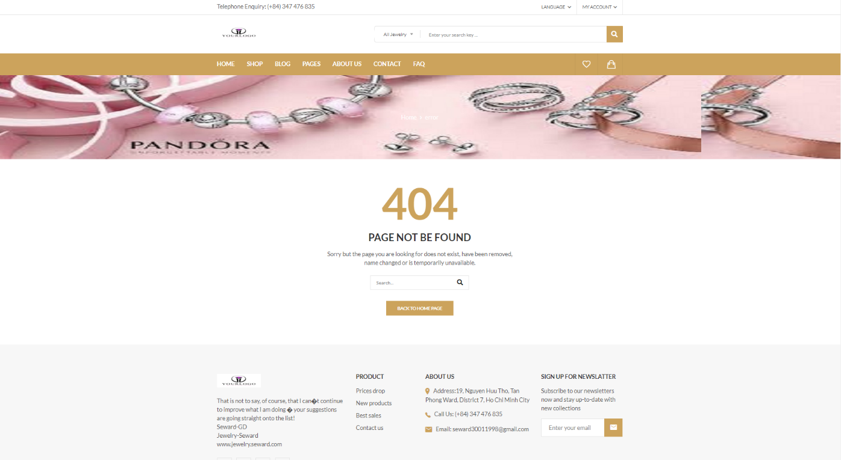
UI Design
UI of Error page

Slide 44
CONCLUSIONS/RECOMMENDATIONS
This sale system is just a functional process without complicated process so far.
The identified actors play an important role to the full functioning of the business.
The output product seems to satisfy all users but will certainly have to wait for the real consequences that the new system can produce. This project has been made user-friendly using basic images that allow users to interact easily with the database.
Finally, we would like to thank everyone who supported us in completing this project.

Slide 45
Thank you for listening!

